Slide 1
JavaScript Objects

Slide 2
JavaScript Objects
Almost everything in JavaScript can be an Object.
Objects are just data, with added properties and methods.

Slide 3
Properties and Methods
Properties are values associated with objects.
Methods are actions objects can perform.

Slide 4
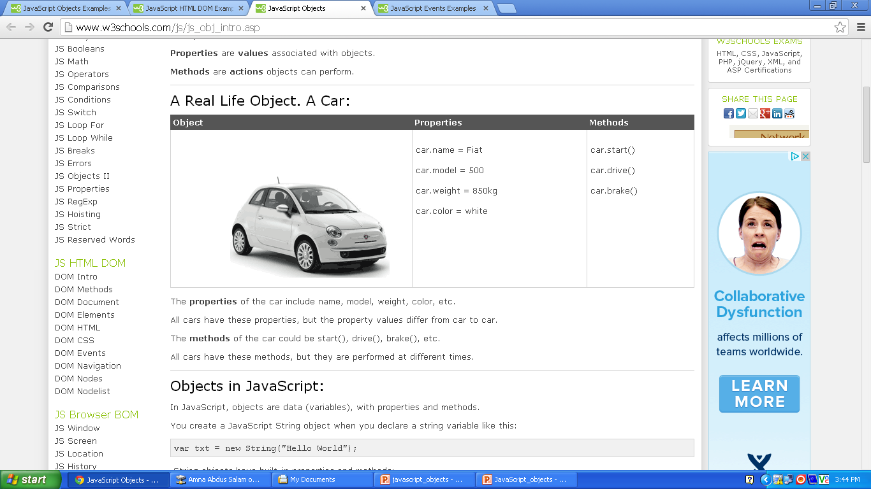
A Real Life Object. A Car:

Slide 5
Car
The properties of the car include name, model, weight, color, etc.
All cars have these properties, but the property values differ from car to car.
The methods of the car could be start(), drive(), brake(), etc.
All cars have these methods, but they are performed at different times.

Slide 6
Objects in JavaScript:
In JavaScript, objects are data (variables), with properties and methods.
You create a JavaScript String object when you declare a string variable like this:
var txt = new String("Hello World");

Slide 7
String objects have built-in properties and methods:
Object | Property | Method
"Hello World" | txt.length | txt.indexOf("World")
The string object above has a length property of 11.
The indexOf("World") method will return 6 (0 is position 1).

Slide 8
Creating JavaScript Objects
Almost "everything" in JavaScript can be objects.
You can also create your own objects.

Slide 9
Using the Keyword: new
This example creates an object called "person", and adds four properties to it:
var person = new Object(); person.firstname = "John"; person.lastname = "Doe"; person.age = 50; person.eyecolor = "blue";

Slide 10
Accessing Object Properties
The syntax for accessing the property of an object is:
objectName.propertyName
This example uses the length property of the String object to find the length of a string:
var message = "Hello World!"; var x = message.length;
The value of x, after execution of the code above will be:
12

Slide 11
Accessing Object Methods
you can call a method with the following syntax:
objectName.methodName()
This example uses the toUpperCase() method of the String object, to convert a text to uppercase:
var message = "Hello world!"; var x = message.toUpperCase();
The value of x, after execution of the code above will be:
HELLO WORLD!

Slide 12
JavaScript Objects

Slide 13
String Object
Find the length of a string
Find the position of the first occurrence of a text in a string - indexOf()
Search for a text in a string and return the text if found - match()
Replace characters in a string - replace()

Slide 14
String Length
The length of a string (a string object) is found in the built in property length:
var txt="Hello World!"; document.write(txt.length);
var txt="ABCDEFGHIJKLMNOPQRSTUVWXYZ"; document.write(txt.length);

Slide 15
Finding a String in a String
The indexOf() method returns the position (as a number) of the first found occurrence of a specified text inside a string:
var str="Hello world, welcome to the universe."; var n=str.indexOf("welcome");
document.write(n);

Slide 16

Replace characters in a string - replace()
<script>
var str ="Visit Microsoft!";
var res = str.replace("Microsoft","Aptech");
document.write(res);
</script>

Slide 17

Take two text boxes. User enters a sting in first box and the length of string is returned in second box.
Hint: [use the event ‘onkeypress’ and ‘length’ property]

